Slide 1
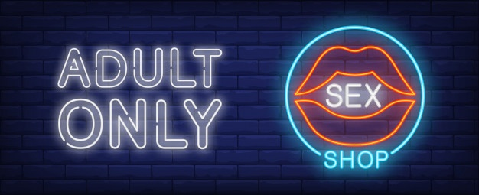
Modeling a Semantic e-Catalog Service:
An Ontology of online commercial institution

Slide 2

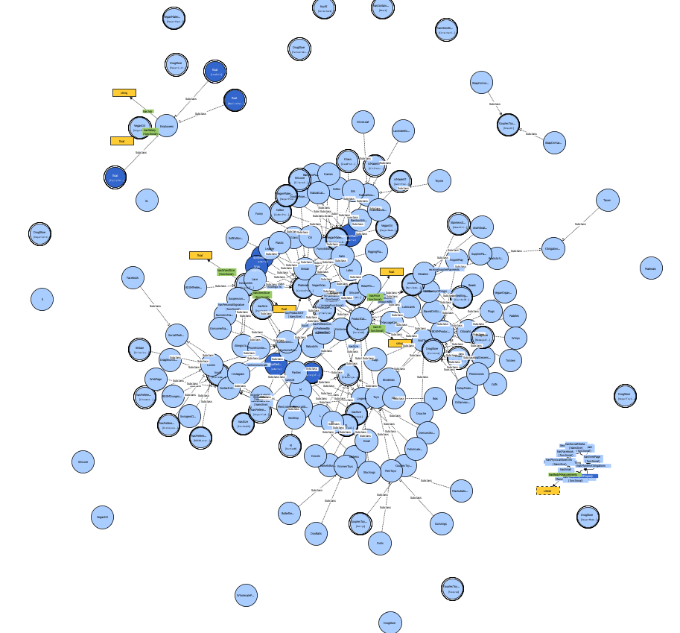

Scope of the project
Construction of a simple-structured ontology in Protégé environment
Personalized e-catalog service system
Preferences
Body measurements
Allergies
1

Slide 3
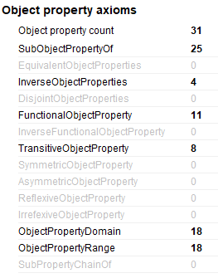
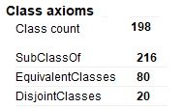
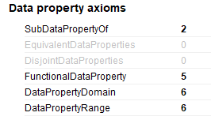
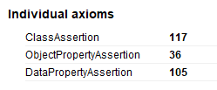
Parts of the Ontology
Object Properties
Data Properties
Classes
Individuals
2

Slide 4
Classes
The individuals
&
Businesses buying products
Channels of Communication
Business's name
SexShop
Duties of the store
Products
Contact
Info
Country of Origin
Customers
Brands
Employees
Manufacturers
Materials
Obligations
Offered items for sale
ProductCategories
Delas
The manufacturer's country of origin
Value Partition
The 'design pattern' for refining the descriptions of classes
Sex shop employees
The substances of which the products are constituted
3
Each of the ten main classes are disjoint with the others

Slide 5
Object Properties
Customer Object Properties
Manufacturer Object Properties
Product Object Properties
SexShop Object Property
hasCountryOfOrigin
produce
receiveSupplierPayments
hasContainer
hasSize
isMadeOf
isPreferredBy
producedBy
hasContactInfo
hasPhysicalStore
hasAdress
hasEmail
hasPhoneNumber
hasSocialMedia
hasFacebook
hasInstagram
hasWebPage
hasMonthlyObligations
salesAt
buyAt
buyProductsOf
canCommunicate
hasPersonalSignature
hasPreferences
isAllergicTo
isMaterialOf
isContactOf
4

Slide 6
hasCountryOfOrigin
Domain: Manufacturers
Ranges: CountryOfOrigin
isContactOf
Domain: ContactInfo
Ranges: SexShop
Object Properties
buyAt
Domain: CustomersCategories
Ranges:PriceTypes
hasPreferences
Domain: CustomerCategories
Ranges: Products
Inverse of: isPreferredBy
isMaterialOf
Domain: Materials
Ranges: ProductCategories
Inverse of: isMadeOf
hasContactInfo
Domain: SexShop
Ranges: ContactInfo
canCommunicate
Domain: CustomersCategories
Ranges: ContactInfo
produce
Domain: Manufacturers
Ranges: ProductCategories
Inverse of: producedBy
buyProductsOf
Domain: CustomersCategories
Ranges: Materials
salesAt
Domain: SexShop
Ranges: CustomerCategories
hasPersonalSignature
Domain: CustomerNames
Ranges: Customers
isAllergicTo
Domain: Consumers
Ranges: Materials
isMadeOf
Domain: ProductCategories
Ranges: Materials
Inverse of: isMaterialOf
isPreferredBy
Domain: Products
Range: Customers
Inverse of: hasPreferences
receiveSupplierPayment
Domain: Manufacturers
Ranges: SupplierPayments
hasSize
Domain: Categories
Ranges: SizeRanges
hasContainer
Domain: Deals
Ranges: ProductCategories
producedBy
Domain: ProductCategories
Range: Manufacturers
5

Slide 7
Data Properties
the size of individual's chest
Domain: Employees
Range xsd:string
not functional as Employees with more responsibilities receive more salaries
hasChestSize
hasChestSize
Domain: Products
Range xsd:string
Functional (unique identification)
hasWaistSize
the size of individual’s waist
hasWeistSize
hasPrice
hasID
hasJob
hasSalary
hasBodyMeasurements
Domain: Consumers
Range xsd:string
Functional
Each individual can have unique meassurements
Domain: Products
Range xsd:string
Functional
Each product can only have one price value.
Domain: Employees
Range xsd:string
Not Functional as Employees can have more than one role (job) in the company
6

Slide 8
Product Categories
Based on Material
Lingerie
Babydolls | Bras | CorsetsBustiers | Costumes | Dresses Skirts| Fetish Latex | Gloves | MenUnderwear | Panties| Stocking
Combo| Cotton| Glass| Latex| Satin| Silicone| Silk| Vegan
Dildos
Glass | Realistic |Steel
Based on Size
AnnalDesensitizers | Condoms | DelayProducts | Lubricants | MassageCandles | MassageOils | Pherormones | TamponCups | VeganCondoms | VeganLubricants | VeganMassageCandles | VeganMassageOils |VeganOrganic|VeganToysCleaners
Shibari
Bamboo Silk Ropes | Double Rope Wrist Cuffs | Rigging Plates | Soft Cotton Ropes | Suspension Rings
L | M | S | XL | XS | XXL
Drug Store
Anal Toys (Beads / Douche / Plugs) | Couple Toys (Sleeves / StrapOn / Swings) | Men Toys ( Cockrings/ Dolls / Masturbators) | WomenToys ( Buttεrflies / DuoBalls)
Vegan Products
Blindfolds | CollarLeash | Cuffs | Gags| NipplePlay | Paddles| Tickers| VeganOrganicToys | Whips
Disjoint with: Funny Edible, Vibrators, Drug Store, Lingerie, Dildos, Toys
BDSM
Products
Toys
Funny
Edible
BachelorParty | Funny| Games
Combo
Products
Vibrators
Combo| Cotton| Glass| Latex| Satin| Silicone| Silk| Vegan
7

Slide 9
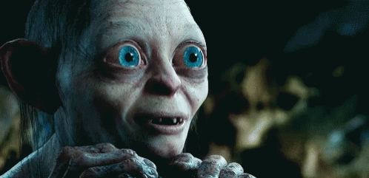
SURPRISE, SURPRISE !!
8

Slide 10
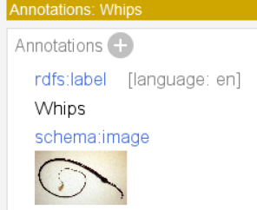
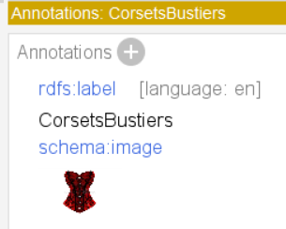
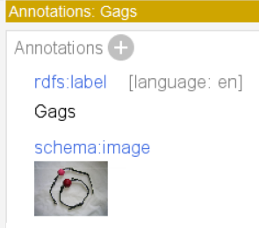
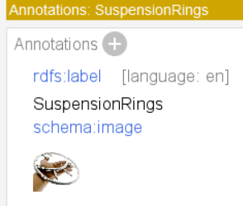
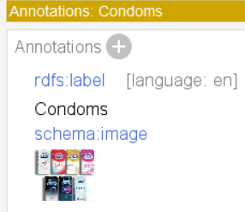
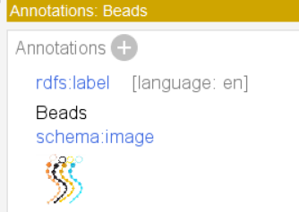
9

Slide 11
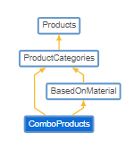
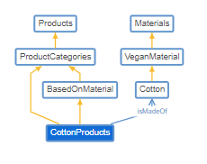
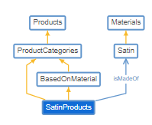
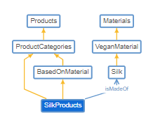
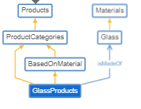
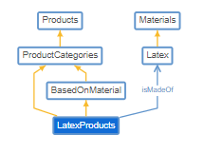
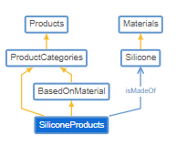
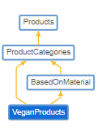
Graphs for Product Categories Based on Materials
10

Slide 12
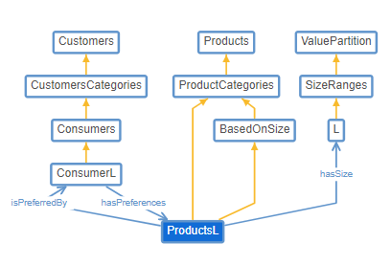
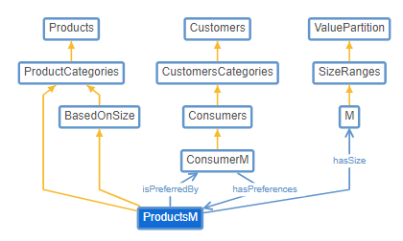
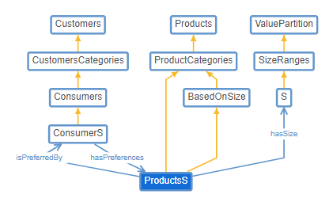
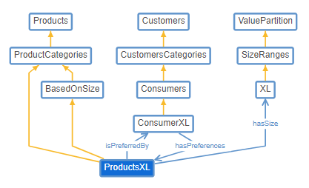
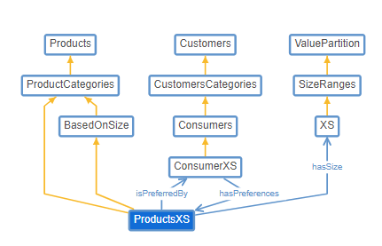
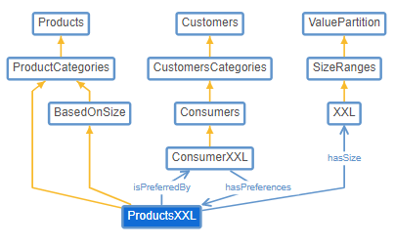
Graphs for Product Categories
Based on Size
11

Slide 13
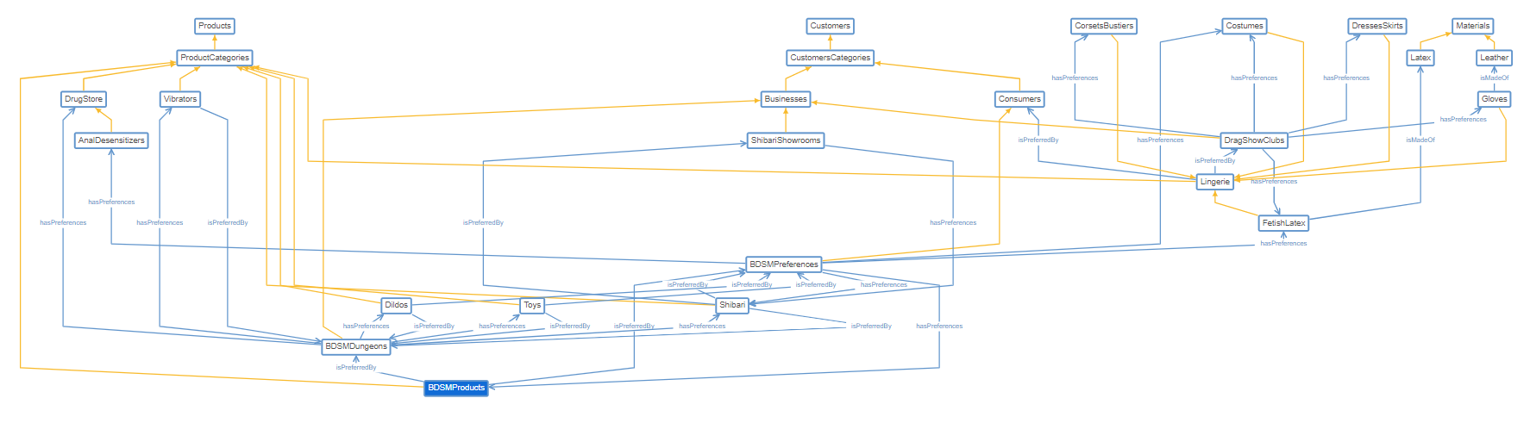
Graphs for Product Categories BDSM Products
12

Slide 14
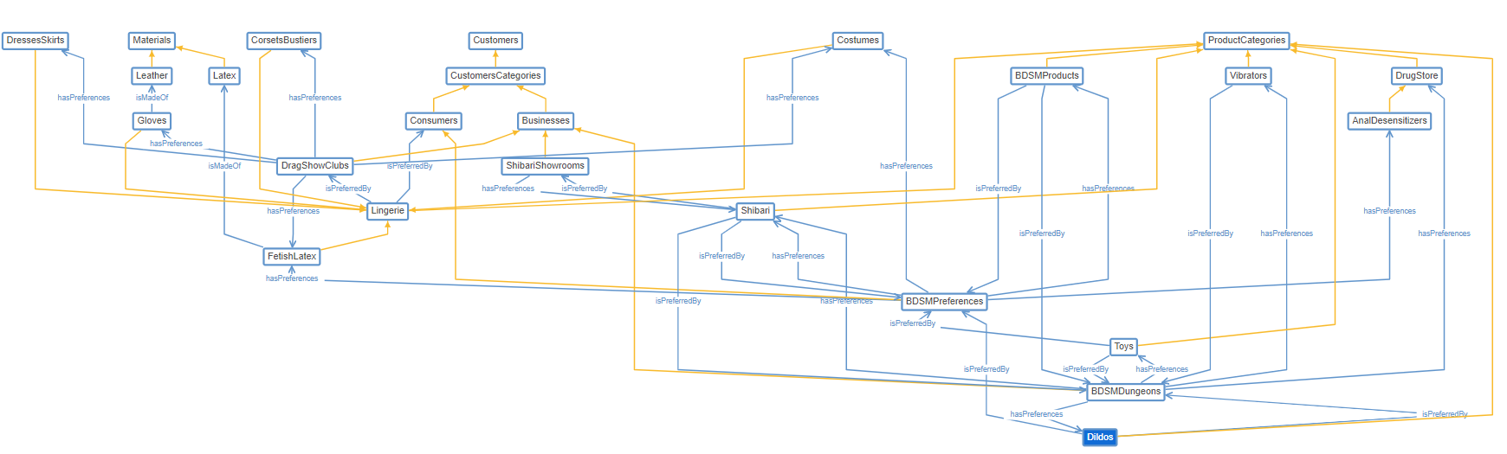
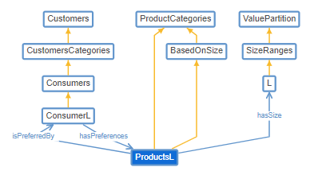
Graphs for Product Categories
Dildos
13

Slide 15
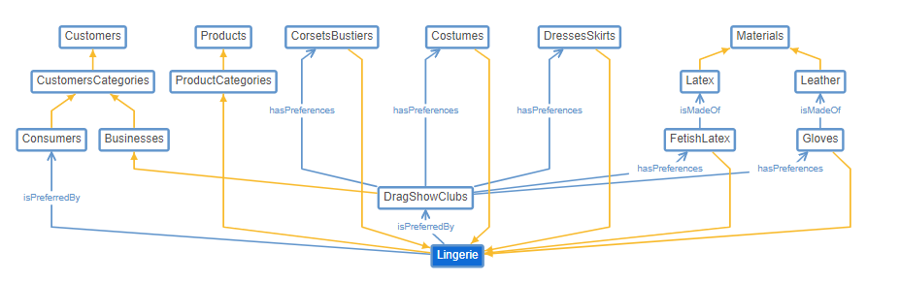
Graphs for Product Categories
Lingerie
14

Slide 16
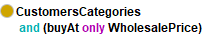
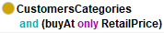
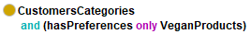
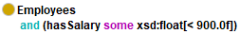
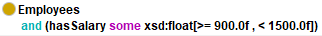
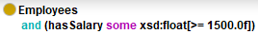
Customers
Customer Categories
Customer Names
Businesses
Lovers
Customers
Vegan customers
Business names
Consumer names
Employees
LowPaid
MediumPaid
HighlyPaid
15

Slide 17
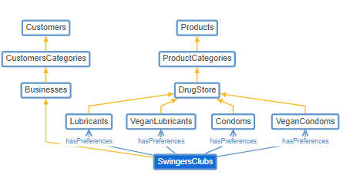
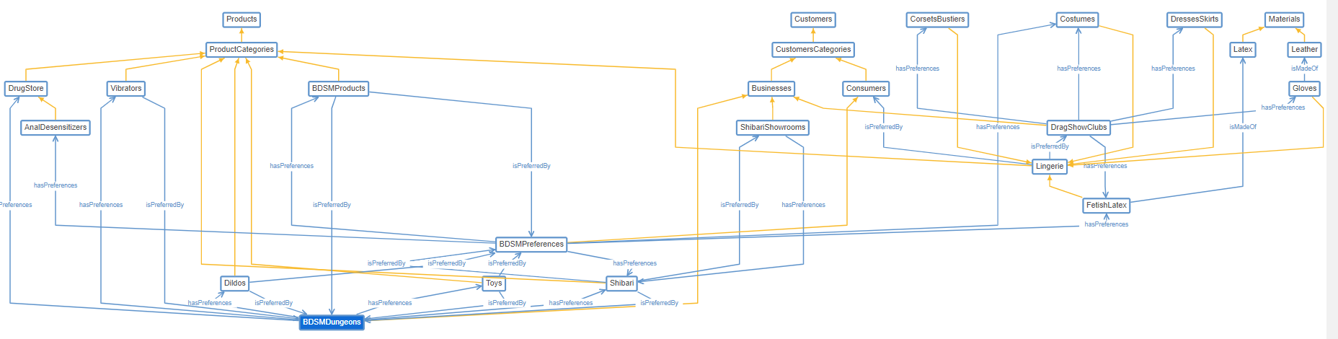
Businesses Customer Categories in Graphs
16

Slide 18
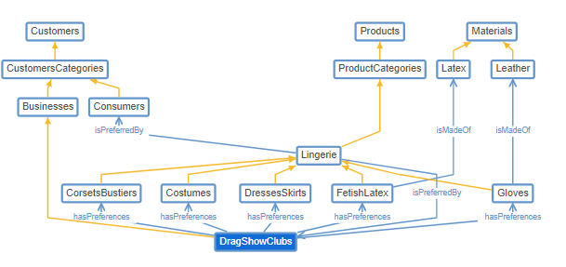
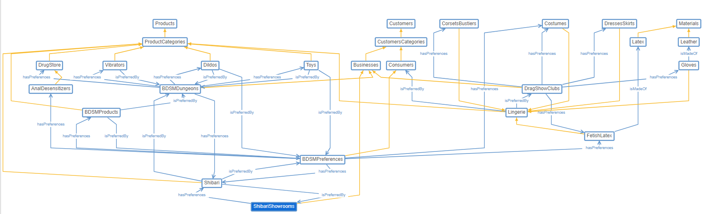
Businesses Customer Categories in Graphs
17

Slide 19

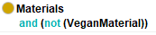
Materials
Glass
Lace
Latex
Leather
Wax
Oil
Plastic
Satin
Silicone
Stainless Steel
Synthetic Fibres
Allergy Candidates
Vegan Material
Cotton | Natural Latex | Natural Soap (Lavender Extracts / Olive Leaf / Thyme) | Silk | Vegan Oil | Vegan Wax | Water Based Lubricants
NonVeganMaterial
18

Slide 20
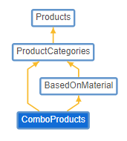
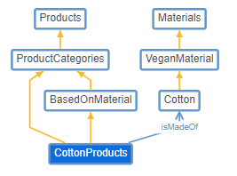
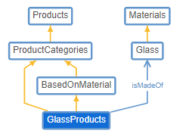
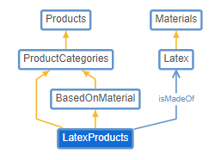
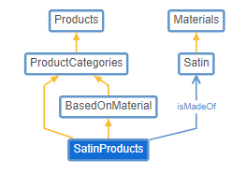
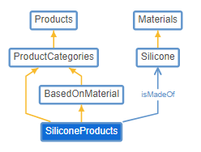
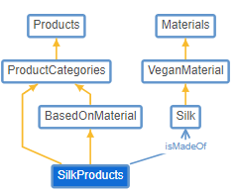
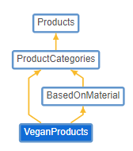
Materials Graph
19

Slide 21



















Manufacturers
As instances
Anal Fantasy
BIOglide
Durex
Fetish Fantasy Series
Intense
KingCock
LELO
Lover Boy
Obsessive
Lingerie
20

Slide 22



Value Partition
The 'design pattern' used to refine the descriptions of various classes
SizeRanges describe the clothing size
XS
S
M
L
XL
XXL
PriceType describe the price's type
wholesale
retail
21

Slide 23






Individuals for Products
In total we have 42 instances for the products
23

Slide 24
Individuals for Customers
18 instances for the customers
24

Slide 25







Individuals for Employees
7 instances for the employees
25

Slide 26
Individuals for Store Information
5 instances for the store information
26

Slide 27


Inferred Knowledge
Asserted View
Inferred View
Have a moment to compare the two pictures.
The second one looks like a catalog!
22

Slide 28

SPARQL Queries / PREFIXES
27

Slide 29


Query 1: All subjects and objects connected by subclassOf predicate, where only classes are encoded as objects.
28

Slide 30

Query 2: All Contact Info
29

Slide 31


Query 3: All employees with jobs and salaries
30

Slide 32


Query 4: Manufacturers by country
31

Slide 33

Query 5: Number of Products
32

Slide 34


Query 6 : All Products with prices
33

Slide 35


Query 7: Top ten cheapest products
34

Slide 36


Query 8: Products between 45 & 100
34

Slide 37


Query 9: Product ID
35

Slide 38


Query 10: All BDSM Products with their description
36

Slide 39


Query 11: All products with the word toys in their comment / description
37

Slide 40


Query 12: Clients / body measurements
38

Slide 41


Query 13: Clients with Signature
39

Slide 42

Query 14: All together
40

Slide 43

Future Work
In terms of
Ontology
Add more Product classes (movies, comics, etc.)
Populate with more instances
Create more knowledge based on object & data properties
More personalized e-commerce based on customer characteristics
Visualization
Explore Neo4j & GraphDB tools
Explore Protégé's capabilities
41

Slide 44

THANK YOU FOR YOUR ATTENTION ☺

